Slide 1
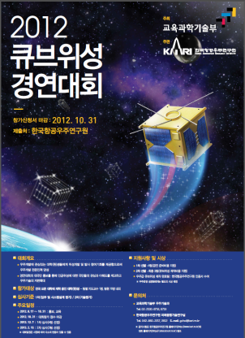
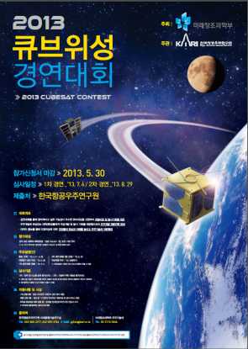
2012,2013 Cubesat Contest : University Cube Satellites Mission and Design Contest in Korea
2013. 9.
Korea Aerospace Research Institute (KARI)

Slide 2
Contents
Introduction of Cubesat Contest
2012 Cubesat Contest
  1st, 2nd Education Program
  1st, 2nd Contest Program
  Finally Selected Missions
2013 Cubesat Contest
  1st, 2nd Education Program
  1st, 2nd Contest Program
  Finally Selected Missions
Conclusion and Future Schedule

Slide 3
Introduction of Cubesat Contest(1/2)
In 2012 and 2012, Korean Aerospace Research Institute (KARI) held the CubeSat contests
  『2012 Cubesat Contest』: 2012 August. 17 ~ 2014. July
  『2013 Cubesat Contest』: 2013. April. 9 ~ 2015. March
Purpose of the contest
  Provide undergraduate and graduate students with opportunities for hands-on experience in satellite development
  Promote interest of general public in space technology
Programs
  Education Program : two workshops: lectures given by experienced satellite engineers from KARI, Universities and Industries
  Contest Program : conducting in two stages during summer vacation
  Cubesat Development program : provide development cost, technical support of cubesat development and space environment test and launch service for the selected missions

Slide 4
Introduction of Cubesat Contest(2/2)
1st, 2nd Contest Evaluation Criteria
 | Evaluation Criteria | Weight
1st Round (Mission idea) | Scientific and Technical Mission Design | 40%
 | System Design
2nd Round (Technical Implementation) | CubeSat Design | 60%
 | Space Environment Test Plan
 | Launch and Operation Plan
Total |  | 100%

Slide 5
『2012 Cubesat Contest』

Slide 6
Schedule
Phase |  | Contents | Results
workshops | 2012.Aug.17 ~ Oct.31 | ( Aug.17) Contest announcement ( Sep.20) 1st Education Workshop (Oct.31) 2nd Education Workshop | Participation by 23 teams (17 universities)
Contest | 2012.Dec.7 | 1st Round (Nov.31) Proposal Submission (Dec. 7) Presentation | Participation by 17 teams (13 universities) Selection of 6 teams
 | 2013.Feb.15 | 2nd Round (Feb. 8) Proposal Submission (Feb.15) Presentation | Participation by 6 1st round winners Selection of 3 teams
Cubesat Development | 2013.Mar. ~ 2014.July | Development of proposed missions | -

Slide 7
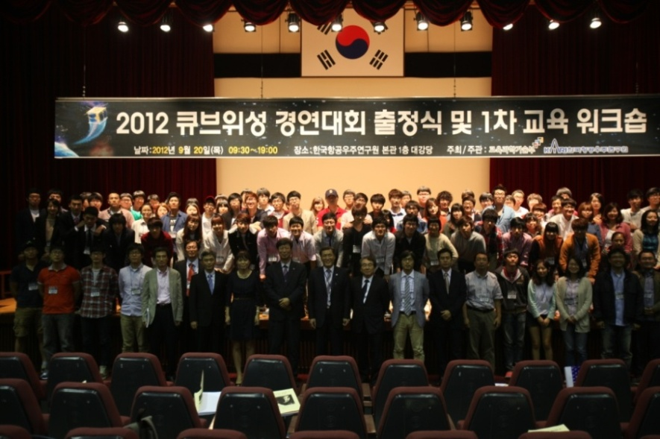
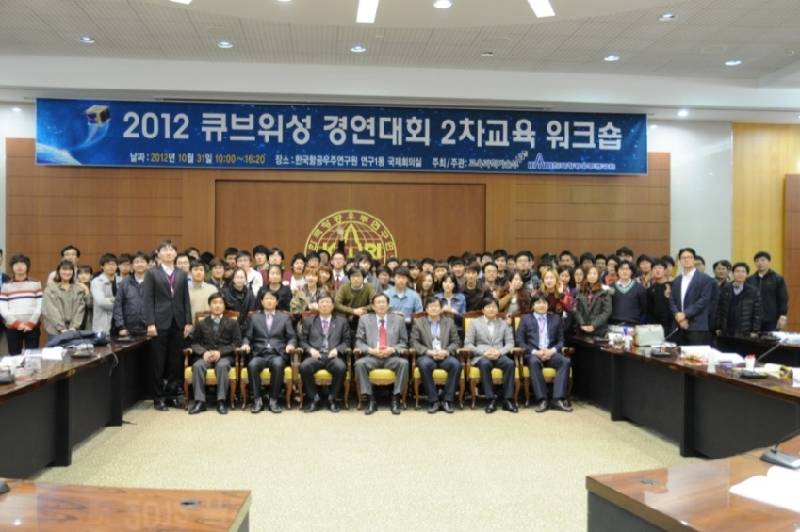
1st, 2nd Education Program
1st Education Workshop (‘12.Sep.20)
  Location : KARI
  Lectures on basics of satellite design by KARI engineers
  Over 120 participants: undergraduate & graduate students, professors
2nd Education Workshop
(‘12.Oct.31)
  Lectures on CubeSat design and development
  Introduction of 1st Contest
  Over 120 participants: undergraduate & graduate students, professors

Slide 8
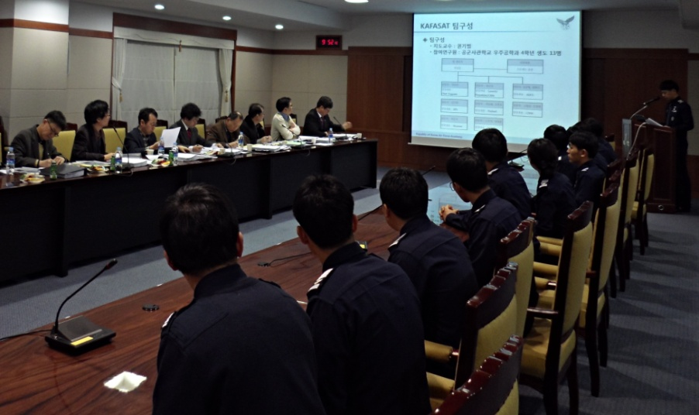
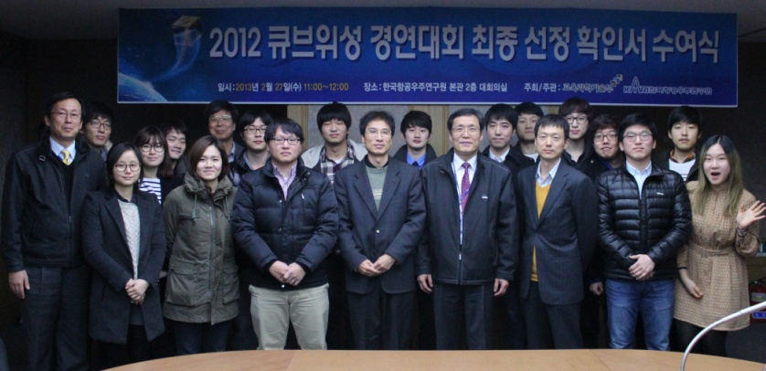
1st, 2nd Contest Program
1st Round (‘12.Dec.7)
  Evaluate Scientific/Technical Mission & System Design
  23 teams applied
  6 teams were selected
2nd Round (‘13. Feb.15)
  Evaluate technical feasibility & implementation plan
  3 teams were selected and awarded development fund
    KAIST, Yonsei Univ, Korea Aerospace Univ.

Slide 9
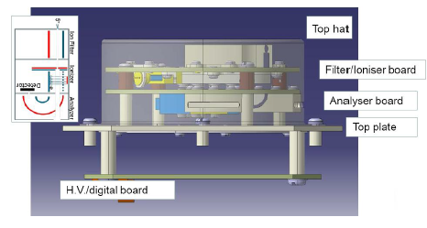
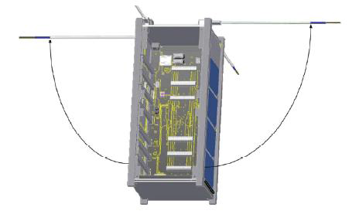
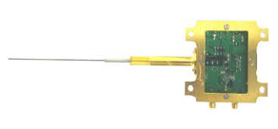
Selected Missions (1/3)
KAIST(2U); * will be launched by QB50(von-Karman Institute) in ‘16
  participate in QB50 program
  QB50: measurement of low ionosphere/thermosphere using 50 CubeSats
  on this CubeSat, Langmuir probe will conduct a simultaneous measurement with ion neutral mass spectrometer
Ion neutral mass spectrometer
Langmuir Probe

Slide 10
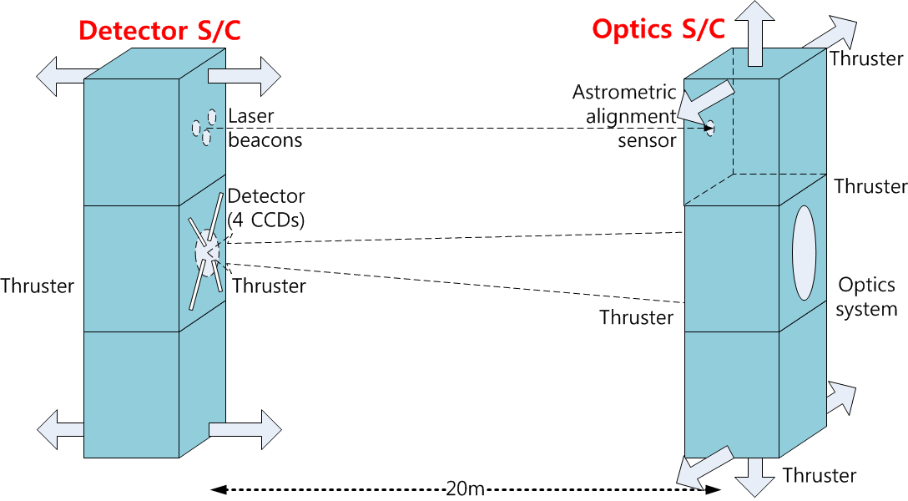
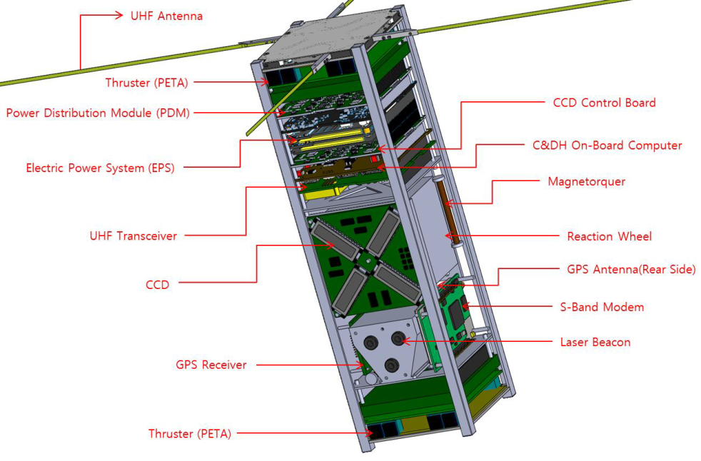
Selected Missions (2/3)
Yonsei Univ.(3U)
  build a detector spacecraft of the two spacecraft that constitute a virtual telescope (optics spacecraft to be developed by MIT)
  involves challenging technologies: attitude control & formation flying

Slide 11
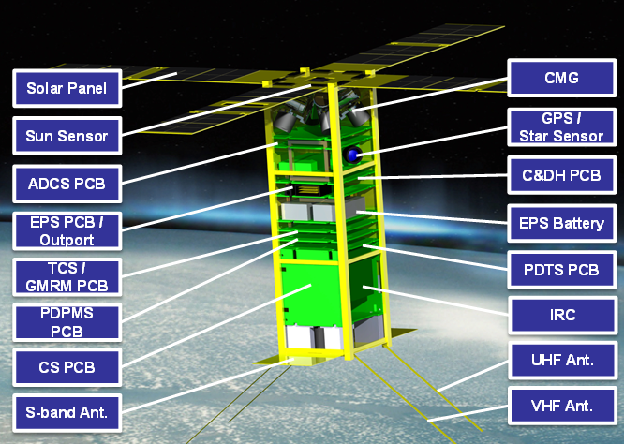
Selected Missions (3/3)
Korea Aerospace Univ.(3U)
  payload: dual band infrared camera (3 – 5 μm):
    Medium Wave IR, Long Wave IR
  Observe thermal images of the Earth

Slide 12
『2013 Cubesat Contest』

Slide 13
Schedule
Phase |  | Contents | Results
workshops | 2013.Apr.9 ~ May.30 | ( Apr.9) Contest announcement ( May.14) 1st Education Workshop (Jun.20) 2nd Education Workshop | Participation by 10 teams (8 universities)
Contest | 2013.Jul.4 | 1st Round (Jul.3) Proposal Submission (Jul.4) Presentation | Participation by 9 teams (10 universities) Selection of 6 teams
 | 2013.Sep.12 | 2nd Round (Sep. 11) Proposal Submission (Sep.12) Presentation | Participation by 6 1st round winners Selection of 3 teams
Cubesat Development | 2013.Oct. ~ 2015.Feb | Development of proposed missions | -

Slide 14
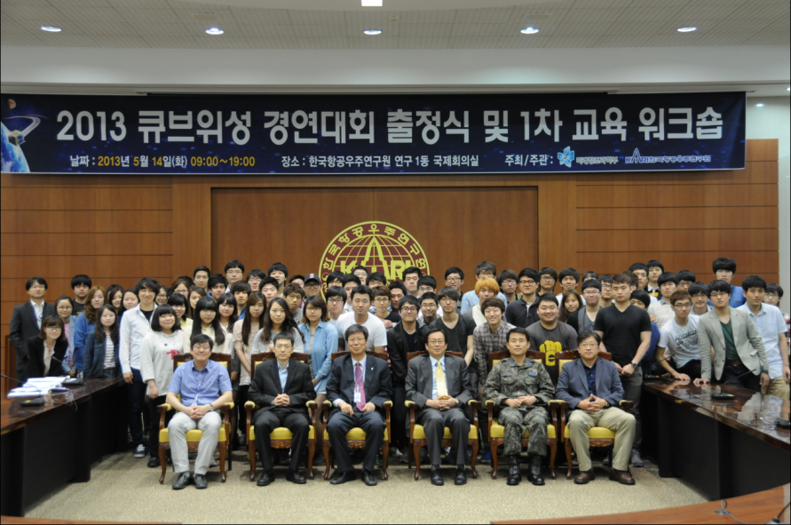
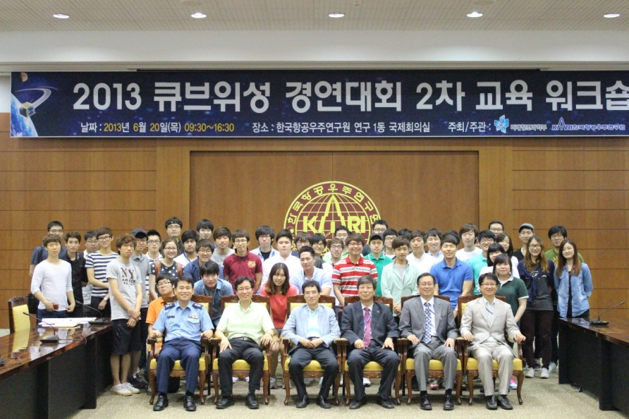
1st, 2nd Education Program
1st Education Workshop (‘13.May.14)
  Location : KARI
  Lectures on basics of satellite design by KARI engineers
  Over 100 participants: undergraduate & graduate students, professors
2nd Education Workshop
(‘13.Jun.20)
  Lectures on CubeSat mission, design
  2012 selected team’s cubesat design
  Over 65 participants: undergraduate & graduate students, professors

Slide 15
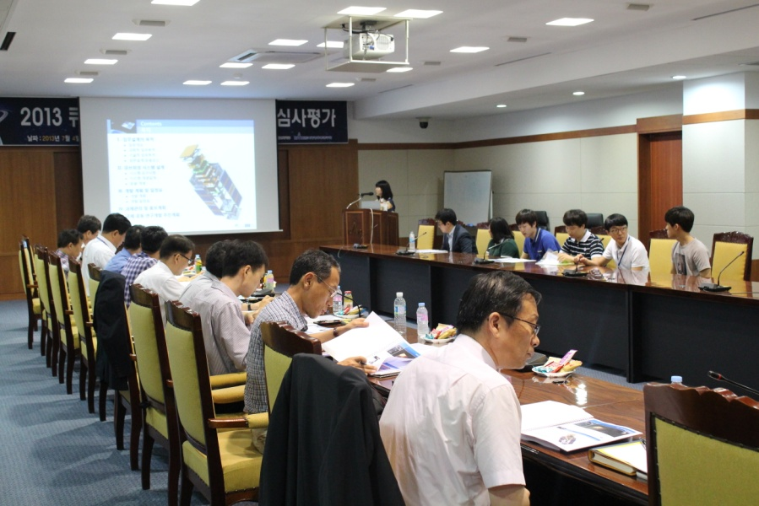
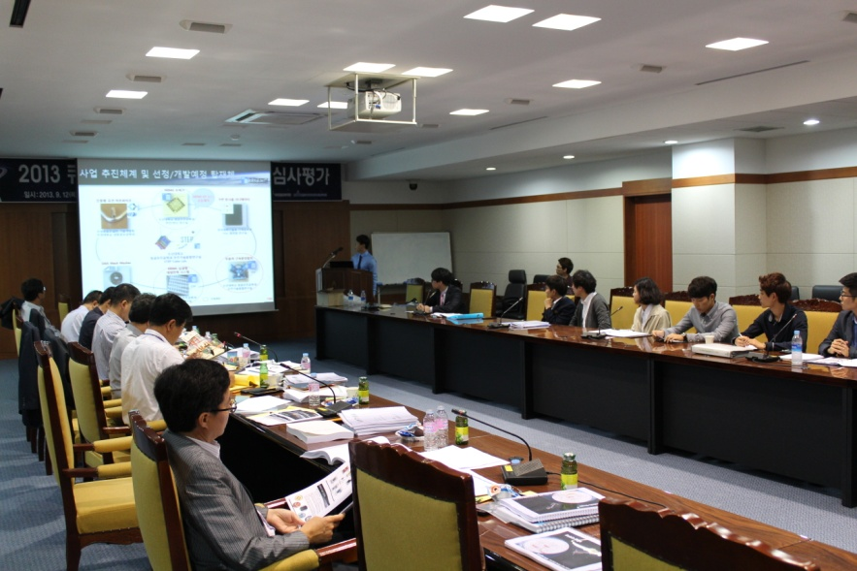
1st, 2nd Contest Program
1st Round (‘13.Jul.4)
  Evaluate Scientific/Technical Mission & System Design
  23 teams applied
  6 teams were selected
2nd Round(‘13. Sep.12)
  Evaluate technical feasibility & implementation plan
  3 teams were selected and awarded development fund
    Kyunghee Univ., Chosun Univ., Chungnam univ.

Slide 16
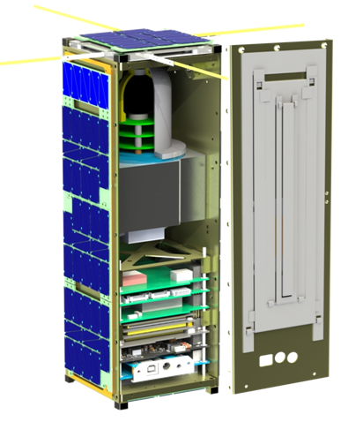
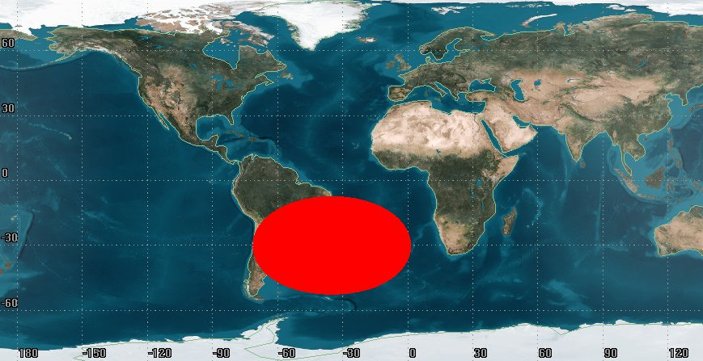
Selected Missions (1/3)
Kyunghee Univ.(3U)
  Payload : Space Radiation Probe and Magnetometer
  on this CubeSat, evaluate biologic effects of space radiation

Slide 17
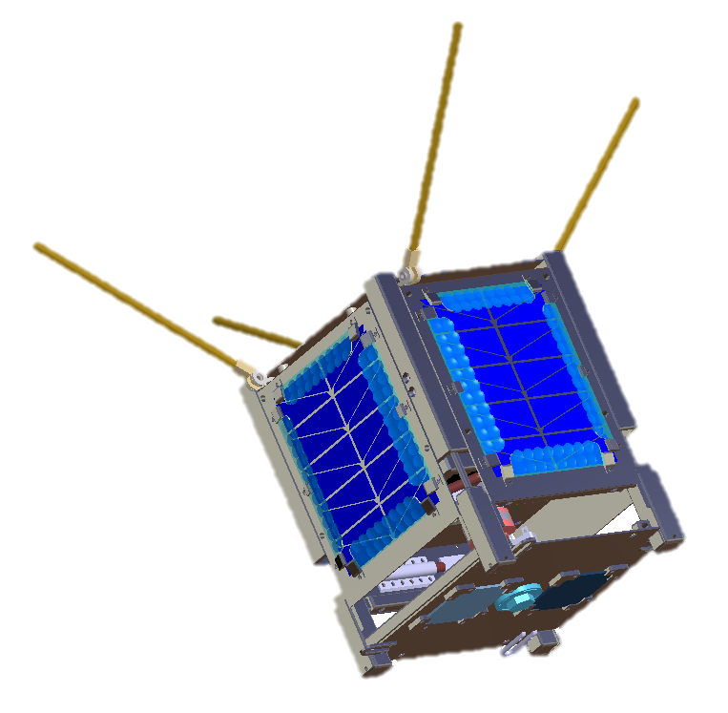
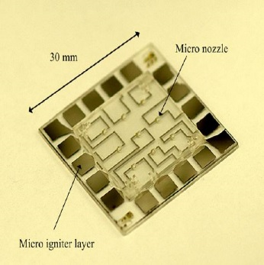
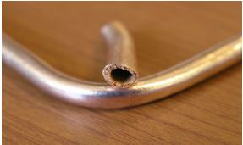
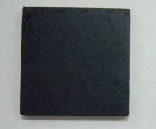
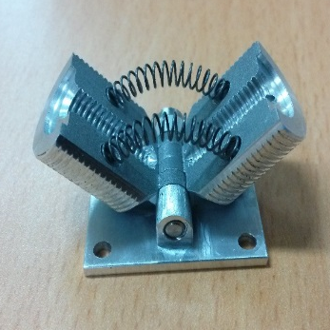
Selected Missions (2/3)
Chosun Univ.(1U)
  payload : MEMS thruster, variable emittance radiator, pulsation flexible heat pipe
  investigate core space technology for using as payloads from industry, university, research institute and verify nano-satellite technology

Slide 18
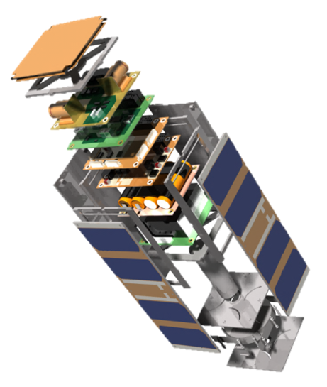
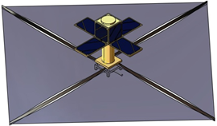
Selected Missions (3/3)
Chungnam Univ.(3U)
  payload: solar-sail
  develop solar-sail and deploy mechanism and verify them in LEO(Low Earch Orbit)

Slide 19
Conclusion
6 Cubesat Teams finally is selected from Cubesat Contest
  3 teams from『2012 Cubesat Contest』and 3 teams from 『2013 Cubesat Contest』
    1 team of these will be launched by QB50 program
  these teams is developing their cubesats,
    2012 cubesat developing teams is scheduled for 2014. Jul.
    2013 cubesat developing teams is scheduled for 2015. Feb.
Future Plans『2013 Cubesat Contest』
  Select Launch Rocket and fix Launch Schedule
    launch schedule : All 5 Cubesats in Q3/Q4 of 2015

